Slide 1
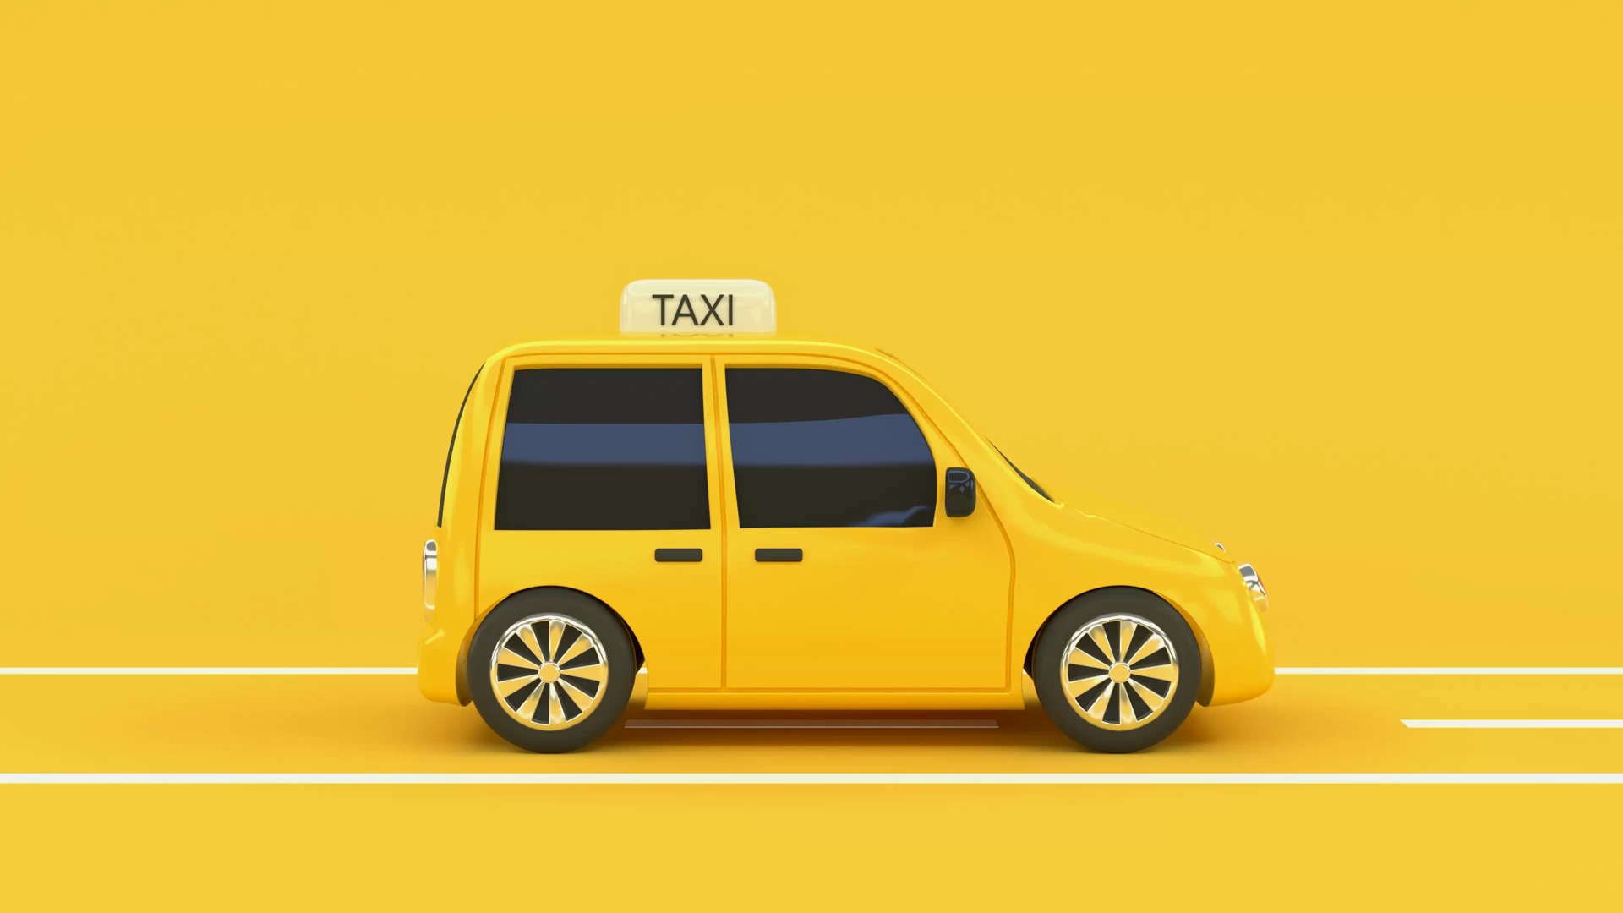
🚖 Taxi Ride Analysis: Insights & Findings
Subtitle: Understanding the key factors influencing ride fares Team Members: Amro Gamar, Abdullah, Hossam Internship: Cellula Internship

Slide 2

Introduction
🔍 Objective of Analysis:
Understand peak hours, distance trends, and fare variations.
Examine the impact of weather, traffic, and passenger count.
Identify key takeaways for riders, drivers, and policymakers.
📊 Dataset Overview:
Contains pickup/drop-off locations, fare amounts, and ride details.
Covers factors like traffic, weather, and time trends.
Data is cleaned by removing missing values and handling outliers.

Slide 3
Ride Patterns – Passenger Count Analysis
👥 How Many Passengers Per Ride?
Most rides have 1-2 passengers, meaning taxis are primarily used for solo or small-group trips.
Large groups (3+ passengers) are rare, suggesting limited demand for group taxi travel.

Slide 4
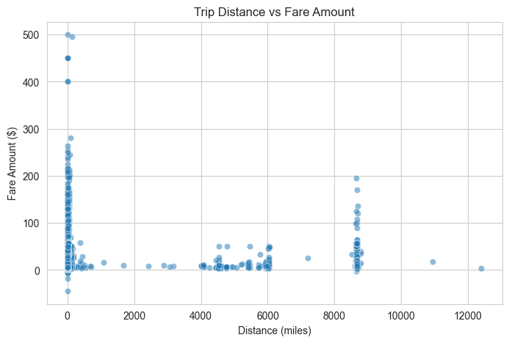
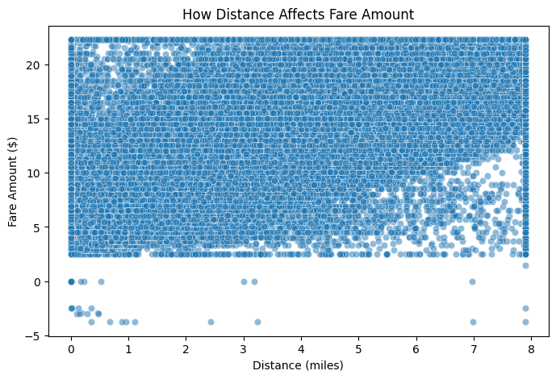
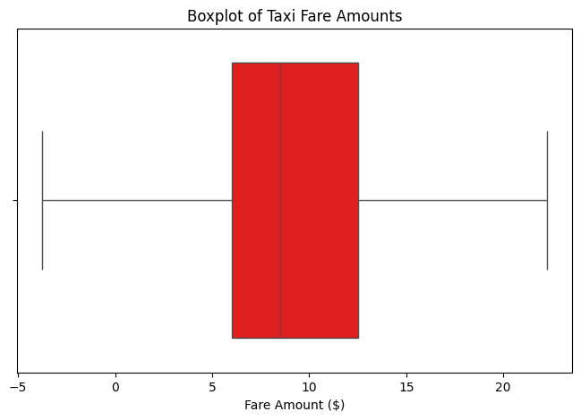
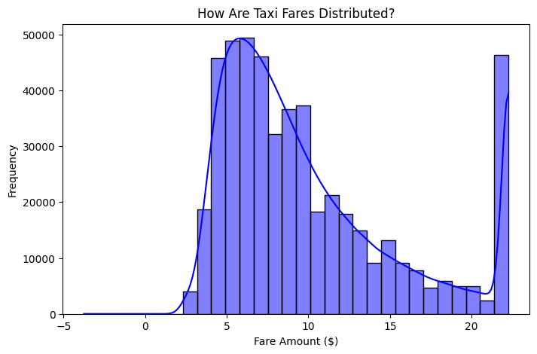
Fare Amount Distribution & Distance Impact
💰 How Are Taxi Fares Distributed?
Most fares range between $5 and $30, making taxis an affordable option.
Some very expensive rides (above $100) exist, likely long-distance trips or premium services.
A boxplot analysis highlights extreme fare outliers.
📏 How Distance Affects Fare Amount
Longer trips generally cost more, but some short trips have high fares, possibly due to surge pricing or additional fees.

Slide 5
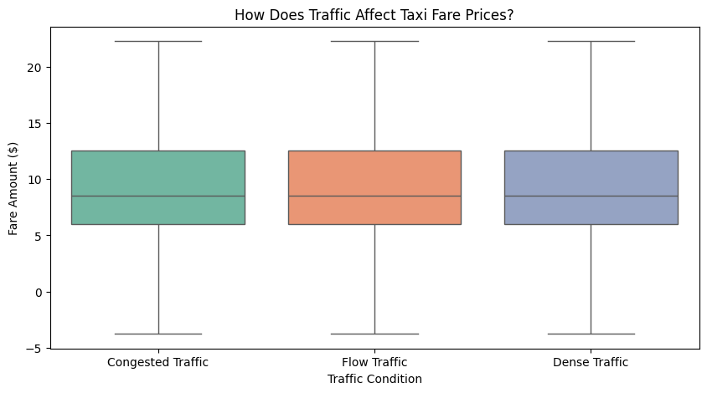
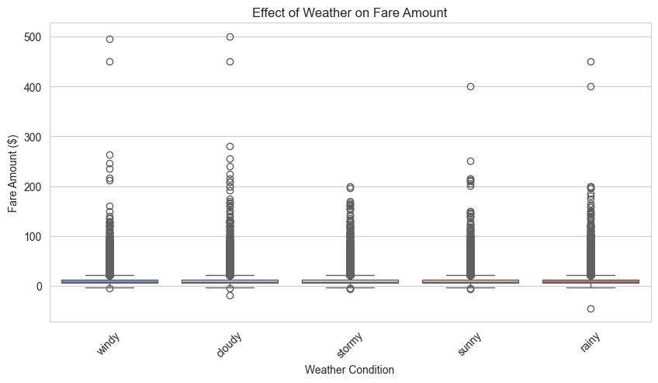
Impact of Traffic & Weather on Fare Prices
How Does Traffic Affect Taxi Fare Prices?
Rides in congested traffic tend to have higher fares, likely due to longer wait times and slow movement.
"Flow Traffic" trips result in more predictable and stable fares.
🌧 Does Weather Impact Taxi Fare Prices?
Surprisingly, fare distribution is similar across different weather conditions.
However, stormy and windy weather may cause slight price increases due to increased demand.

Slide 6
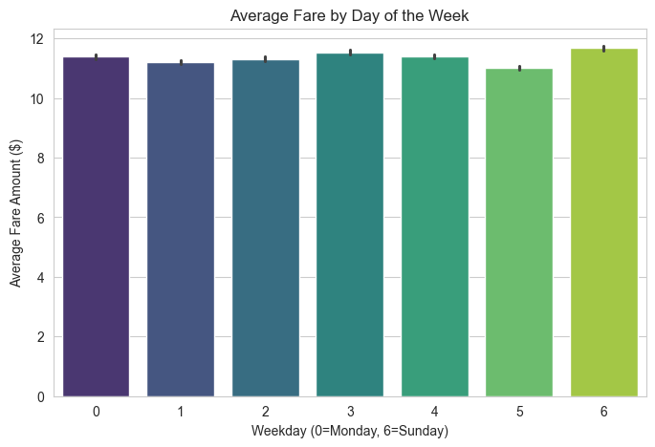
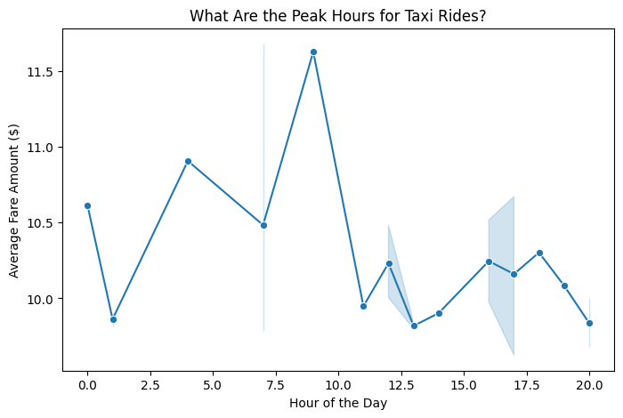
⏰ When Do People Use Taxis the Most?
📅 Weekday Peak Hours
Morning Rush (6-9 AM): Sharp rise, peaking at 8-9 AM (commuters).
Evening Rush (5-8 PM): Highest demand, peaking at 6-7 PM (work commutes).
Late Night Decline: Demand drops significantly after 10 PM.
🎉 Weekend Peak Hours
No Morning Peak: People wake up later, so morning demand is low.
Steady Growth (Noon-9 PM): Gradual increase throughout the day.
Night Demand (8 PM-Midnight): Higher late-night activity (social outings).

Slide 7
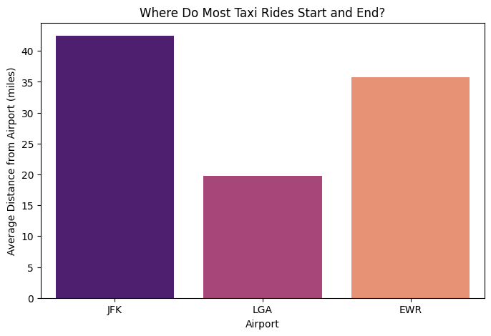
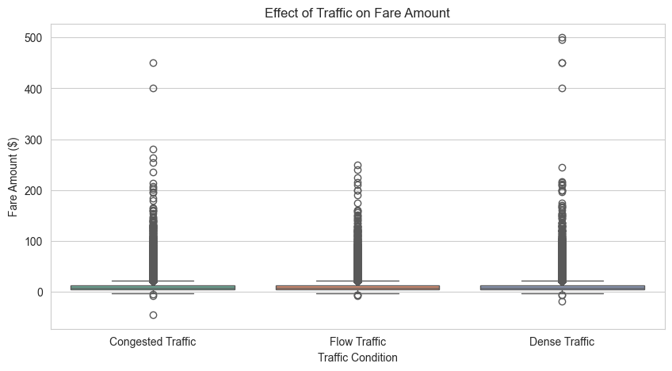
Where Are the Most Taxi Rides?
📍 Where Do Most Taxis Pick Up and Drop Off Passengers?
High ride demand near major airports like JFK, LaGuardia (LGA), and Newark (EWR).
Suggests that airport transportation is a key revenue driver for taxis.

Slide 8
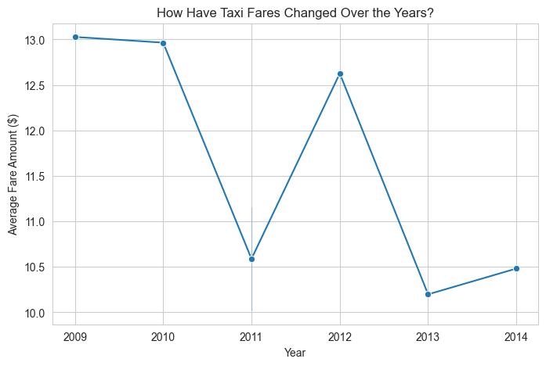
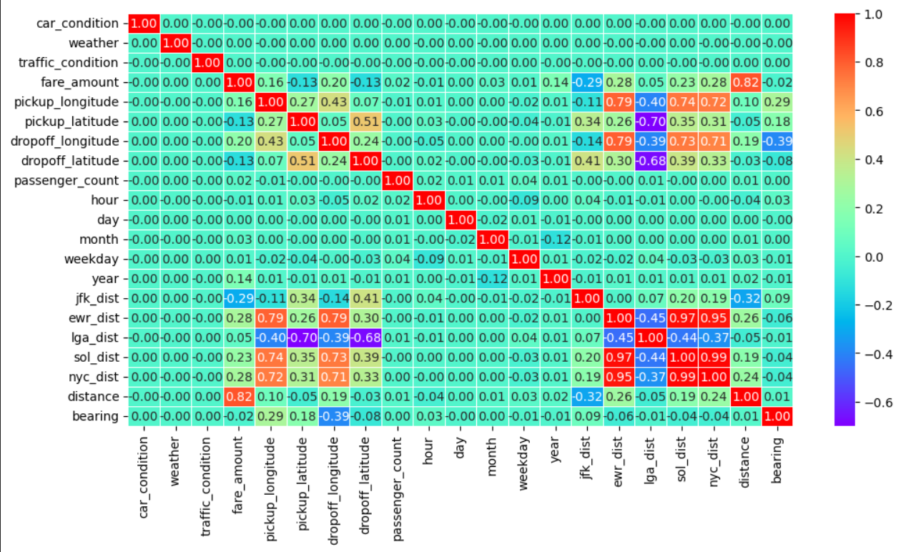
Time Series Analysis & Feature Correlations
📈 How Have Taxi Fares Changed Over Time?
Overall fare amounts increased over the years, likely due to inflation, demand changes, or policy adjustments.
2014 & 2015 had the highest fares (~$12-$13) per ride.
2009-2011 had the lowest fares (~$10 or less) per ride.
Fares tend to rise in the first half of the year and stabilize later.
📊 Which Factors Affect Taxi Fare Prices the Most?
A correlation heatmap reveals:
Distance is the strongest factor affecting fare prices (high positive correlation).
Traffic and weather have a smaller impact than expected.
Pickup location near major areas (e.g., airports) may slightly influence fares.

Slide 9

Key Takeaways & Recommendations
📝 Key Takeaways
Most rides are short and affordable, but a few long and expensive trips exist.
Traffic congestion increases fare prices due to longer trip durations.
Weather has minimal impact, but stormy conditions might lead to slightly higher fares.
Weekdays have clear peak hours, while weekends see steady demand growth.
Airports are high-demand locations for taxi rides.
🚀 Recommendations
Avoid congested traffic when possible to reduce costs.
Plan travel during off-peak hours for cheaper rides.
If heading to the airport, taxis remain a reliable option.

